Slide 1

Getting Started with
Nvivo

Slide 2

Workshop Facilitator:
Sara Whitver is the Digital Humanities Librarian. They run the Alabama Digital Humanities Center and is the library liaison for the Department of English. You can reach them at: smwhitver@ua.edu

Slide 3

adhc.lib.ua.edu

Slide 4
Overview
Today, we are going to get a very basic introduction to the qualitative research software package, Nvivo.
How to start and save a project
How to upload data files
How to perform basic coding
We aren’t planning to do any hands-on playtime today, but I am going to provide follow-up information for you to use.

Slide 5
Note
The layout of NVivo is different on Macs and PCs so today. Sara will be demonstrating NVivo on a PC.

Slide 6
Qualitative coding is the process by which segments of data are identified as relating to, or being an example of, a more general idea, instance, theme or category... Whether coding manually or using software, you will build up a system to organize data and your ideas about it. Coding therefore manages and orders qualitative data

Slide 7
Resources for Qualitative Coding
Skjott Linneberg, M. and Korsgaard, S. (2019), "Coding qualitative data: a synthesis guiding the novice", Qualitative Research Journal, Vol. 19 No. 3, pp. 259-270. https://doi.org/10.1108/QRJ-12-2018-0012.
Ortlieb, Evan. "Qualitative Coding Techniques: Basic Approaches to Get You Started!." In Sage Video. : Vanguard Academy, 2021. Video, 00:05:21. https://doi.org/10.4135/9781529624892.
Maguire, Moira, and Brid Delahunt. "Doing a thematic analysis: A practical, step-by-step guide for learning and teaching scholars." All Ireland journal of higher education 9, no. 3 (2017). https://doi.org/10.62707/aishej.v9i3.335

Slide 8
Files | The collective term for your research materials | An external file represents data outside of NVivo that cannot be imported (such as a book or archival footage). Data Material Documents Survey Transcript Project items

Slide 9
Code | A virtual container that lets you collect content across sources to group related material together. | Node Theme Category Topic Concept

Slide 10
Case | A virtual container that represents your research subjects | Units of observation Units of analysis Objects of study

Slide 11
Coding | The action of assigning source content to a node or case. | Quotations Analysis Tagging

Slide 12
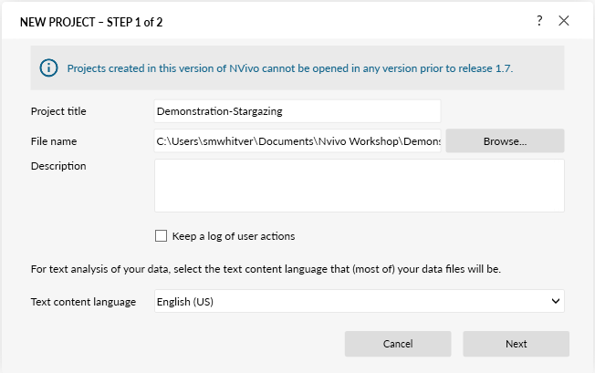
Starting and Saving a Project

Slide 13
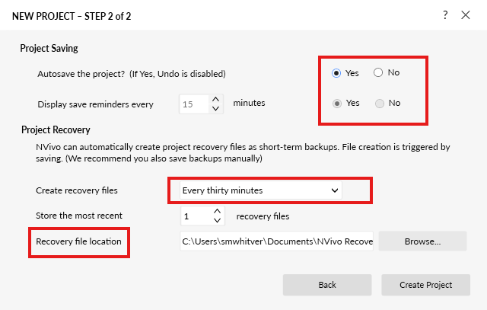
Starting and Saving a Project

Slide 14
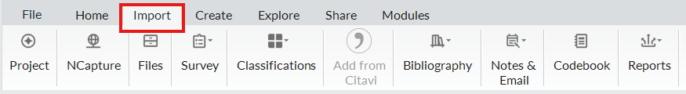
Uploading Your Data

Slide 15
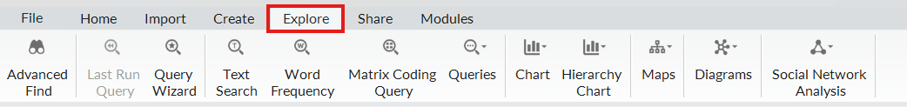
Explore Your Data

Slide 16
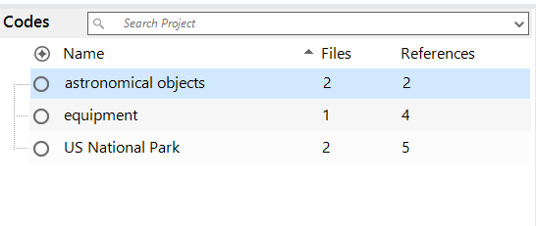
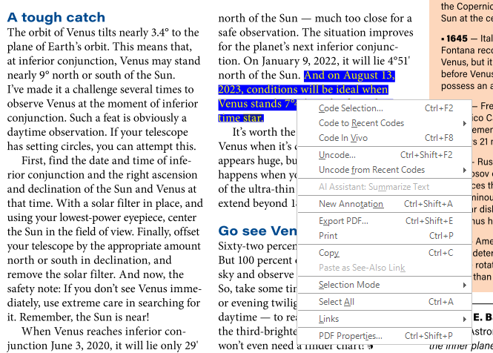
Code Your Data

Slide 17
Links and Resources
Download from OIT: https://oit.ua.edu/software/nivivo/
Library Guide for Nvivo: https://guides.lib.ua.edu/nvivo
NVivo Tutorials: Getting Started with NVivo: https://lumivero.com/resources/support/getting-started-with-nvivo/nvivo-tutorials/
adhc.ua.edu

